Slide 1



NeuroPhone
Real-Time Brain-Mobile Phone Interface
Faculty of Computer and Information Science, Ain Shams University

Slide 2
Under the supervision of
Dr. Manal Mohsen Tantawy
TA Omar Sherif
Scientific Computing Department

Slide 3
Meet our team
Ayman Hassan
Abdelrahman sayed
Mohamed Nour
Nour Mohmed Kamaly
Nora Ekramy
Nourhan Abdelkarim

Slide 4
Table of contents
1
3
2
6
First seminar recap
System architecture & implemented algorithms
Illustration of implementation results
4
5
Demo
Hardware
Next phases (challenges/enhancement)

Slide 5
First seminar recap
1

Slide 6
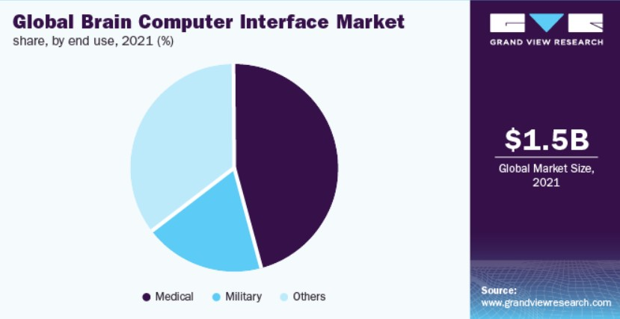
Problem definition & motivation
According to the World Health Organization (WHO), more than 1 billion people globally have some form of disability, and around 15% of the world's population has a disability. The business problem faced by people with disabilities who need a brain speller is the lack of affordable and accessible brain-speller technology in the market.

Slide 7
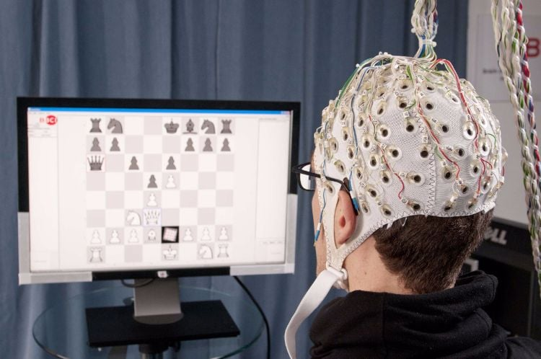
Problem definition & motivation
Brain-spellers are devices that enable individuals with disabilities to communicate by interpreting their brain activity and translating it into text or speech. However, the high cost of these devices and the limited availability of trained professionals to help individuals with disabilities use them effectively make it difficult for many people to access this technology. This results in a significant communication barrier for individuals with disabilities, limiting their ability to interact with others and participate fully in social, educational, and professional activities.

Slide 8

Objective
Develop a technology that can use p300 signals directly from the brain to help disabled people interact with machines, especially cell phones.

Slide 9
2
System architecture & implemented algorithms

Slide 10
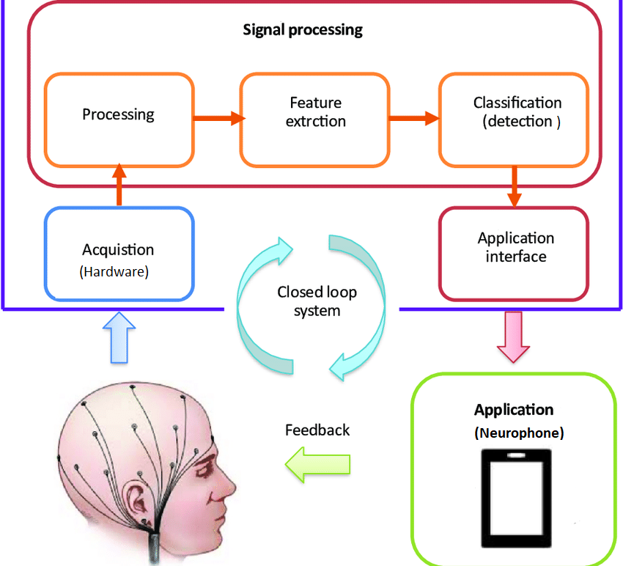
System architecture

Slide 11
EPFL Data
Gender
89%
11%
Male
Female
Age range
27-32
44.4%
Physical disability
33-47
33.3%
Disable
5/9
48-56
22.2%
Healthy
4/9

Slide 12
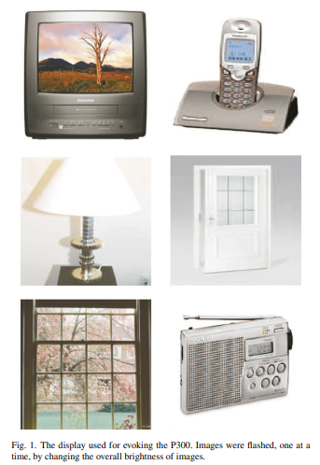
Single run
For a single run, the subject is asked to focus on one image.
For a single run, the images on the grid were flashed in random sequence. The sequence of flashes was block-randomized, this means that after six flashes each image was flashed once, after twelve flashes each image was flashed twice, etc.
We essentially have 6 runs inside a session because we have 6 images in our paradigm. So, each run is essentially dedicated for one image.
We have data of 8 subjects. (from 1 to 9, 5 is excluded).
Each subject has data of 4 recording sessions.

Slide 13
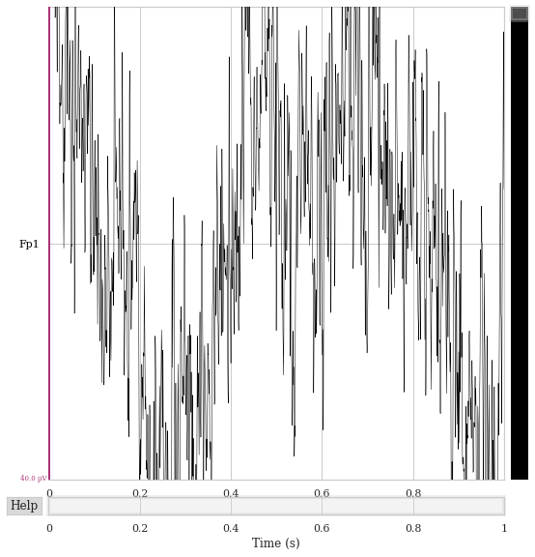
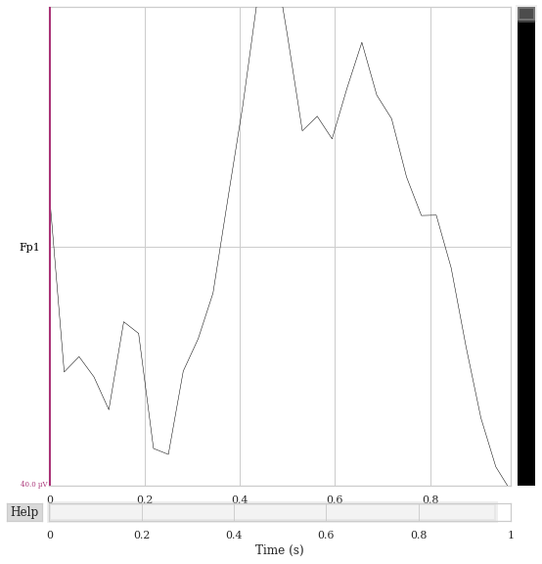
Preprocessing
On a single segment of data :
1. Referencing. The average signal from the two mastoid electrodes was used for referencing.
2. Filtered the signal using a butterworth filter of order 3 to have signal ranging from 1 to 12 Hz
3. Down sampled the signal by 64 Hz
4. Normalization of the signal (minmax normalization , z-score)
Windsorizing the signal: replacing the extreme values with a less extreme value that is still within a range.
Scaling. The samples from each electrode were scaled to the interval [−1, 1].

Slide 14
Modeling – Machine Learning
Support Vector Machines : is a powerful supervised machine learning algorithm that uses support vectors to find the optimal hyperplane that separates different classes of data. The support vectors are the data points closest to the decision boundary and play a crucial role in determining the position and orientation of the hyperplane.
Decision Trees : a ML algorithm that creates a tree-like model where each internal node represents a decision based on a feature, while each leaf node represents a class or value. The algorithm works by selecting the feature that provides the most information gain or reduction in entropy at each stage of the tree building process. The information gain is calculated using a specific metric, such as Gini impurity or entropy, which measures the homogeneity of the subsets after the split.
Linear Discriminant Analysis: is a supervised machine learning algorithm used for classification tasks. It is a statistical method that works by finding a linear combination of features that can best separate the classes in the data. The goal of LDA is to maximize the between-class variance while minimizing the within-class variance.
Logistic Regression

Slide 15
Modeling – Deep Learning
Models experimented with:
- EEGNet
- ChronoNet Version 1
- ChronoNet Version 2
- ChronoNet Version 3
- Deep Recurrent Convolution Neural Networks
- Convolution Neural Netwoks

Slide 16
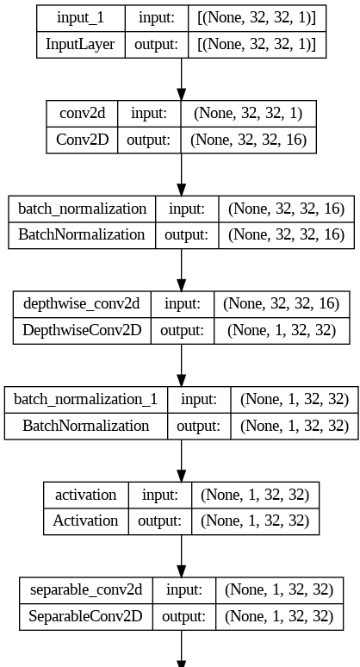
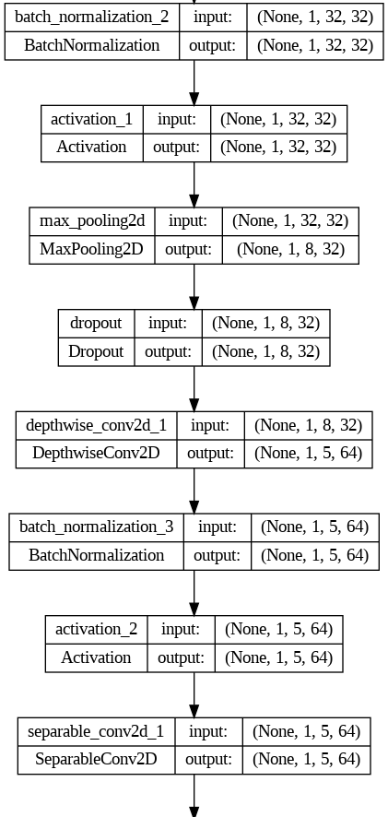
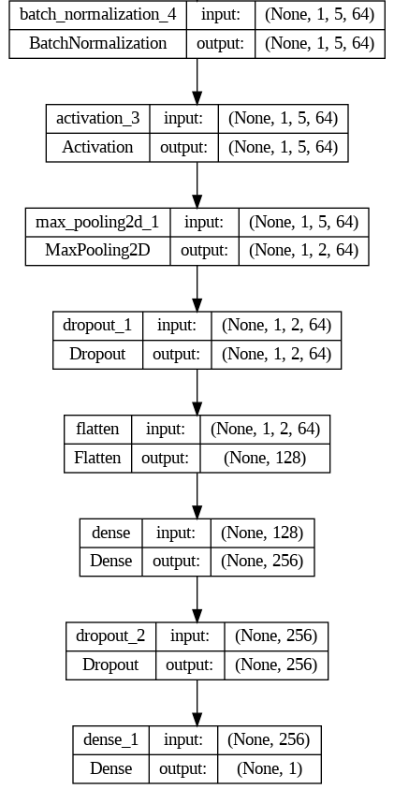
EEGNet Architecture

Slide 17
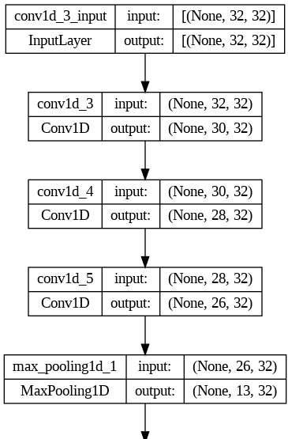
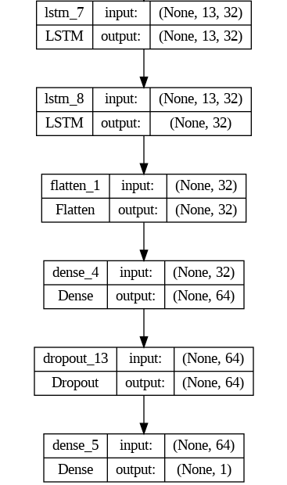
ChronoNet V1 Architecture

Slide 18
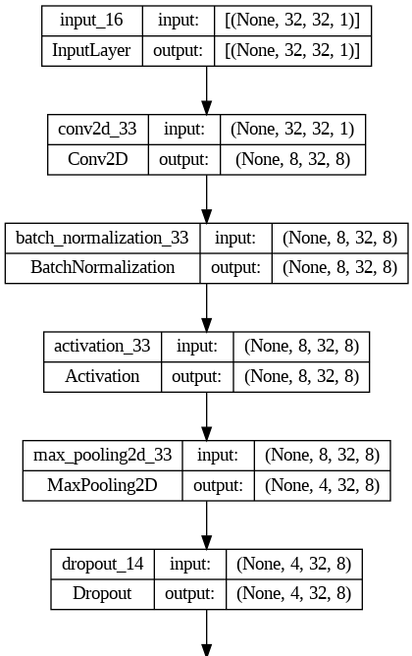
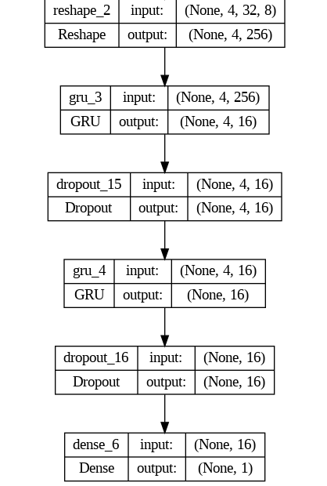
ChronoNet V2 Architecture

Slide 19
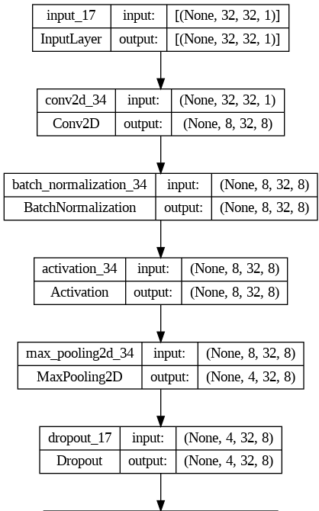
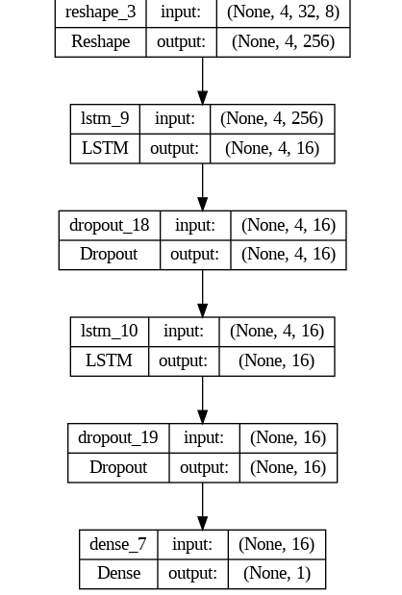
ChronoNet V3 Architecture

Slide 20
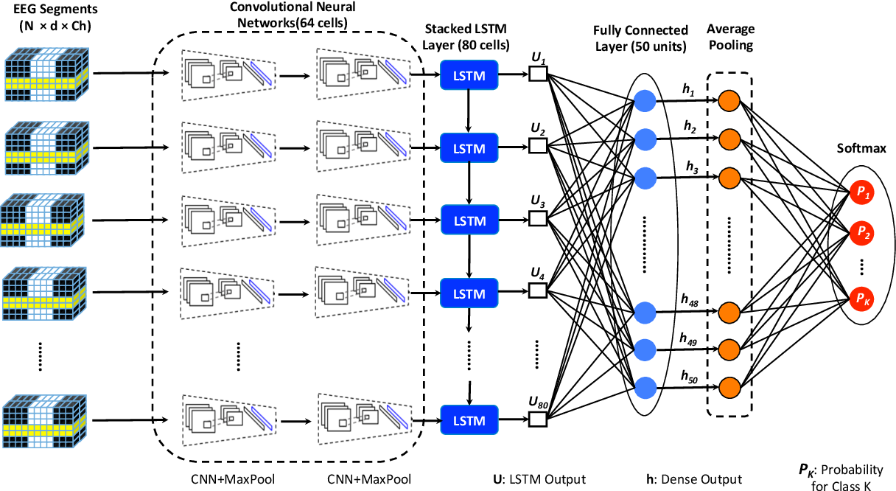
Deep Recurrent Convolution Neural Networks

Slide 21
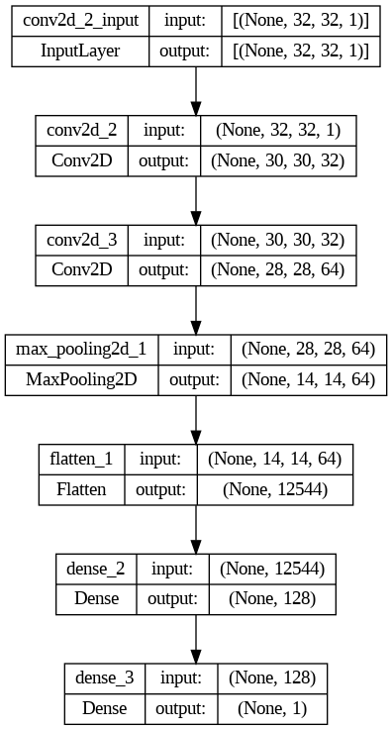
Convolution Neural Network Architecture

Slide 22
Challenges
Subject dependency: in most papers, the model is trained on a single subject and testing is done on data from the same subject
Multiple repetitions: in most papers, we test the same signal multiple times and take the highest repeated label as its predicted label, this adds time and more complexity, also less user acceptability
In our experiments, we predict the signal label from a single repetition.

Slide 23
3
Illustration of implementation results

Slide 24
Machine Learning Results – Logistic Regression
 | Precision | Recall | Average Acuuracy
Subject 1 | 0.42 | 0.41 | 0.65
Subject 2 | 0.42 | 0.42 | 0.65
Subject 3 | 0.57 | 0.67 | 0.78
Subject 4 | 0.56 | 0.58 | 0.74
Subject 6 | 0.51 | 0.64 | 0.76
Subject 7 | 0.5 | 0.54 | 0.71
Subject 8 | 0.73 | 0.62 | 0.79
Subject 9 | 0.42 | 0.39 | 0.64

Slide 25
Machine Learning Results – LDA
 | Precision | Recall | Average Accuracy
Subject 1 | 0.41 | 0.43 | 0.65
Subject 2 | 0.31 | 0.34 | 0.6
Subject 3 | 0.55 | 0.64 | 0.77
Subject 4 | 0.48 | 0.52 | 0.7
Subject 6 | 0.46 | 0.61 | 0.73
Subject 7 | 0.42 | 0.51 | 0.68
Subject 8 | 0.69 | 0.6 | 0.77
Subject 9 | 0.35 | 0.44 | 0.64

Slide 26
Deep Learning Results – EEGNet
 | Precision | Recall | Average Accuracy
Subject 1 | 0.63 | 0.79 | 0.89
Subject 2 | 0.54 | 0.79 | 0.84
Subject 3 | 0.75 | 0.86 | 0.93
Subject 4 | 0.68 | 0.83 | 0.9
Subject 6 | 0.64 | 0.81 | 0.89
Subject 7 | 0.68 | 0.88 | 0.9
Subject 8 | 0.83 | 0.92 | 0.95
Subject 9 | 0.6 | 0.78 | 0.86

Slide 27
Deep Learning Results – ChronoNet V2
 | Precision | Recall | Average Accuracy
Subject 1 | 0.46 | 0.78 | 0.79
Subject 2 | 0.43 | 0.73 | 0.77
Subject 3 | 0.59 | 0.78 | 0.87
Subject 4 | 0.57 | 0.76 | 0.86
Subject 6 | 0.57 | 0.76 | 0.86
Subject 7 | 0.52 | 0.79 | 0.84
Subject 8 | 0.72 | 0.89 | 0.92
Subject 9 | 0.51 | 0.74 | 0.83

Slide 28
Deep Learning Results – ChronoNet V3
 | Precision | Recall | Average Accuracy
Subject 1 | 0.52 | 0.74 | 0.82
Subject 2 | 0.42 | 0.7 | 0.77
Subject 3 | 0.62 | 0.81 | 0.88
Subject 4 | 0.55 | 0.79 | 0.86
Subject 6 | 0.52 | 0.83 | 0.83
Subject 7 | 0.52 | 0.86 | 0.83
Subject 8 | 0.65 | 0.87 | 0.9
Subject 9 | 0.51 | 0.8 | 0.82

Slide 29
Deep Learning Results – DRCNN
 | Precision | Recall | Average Accuracy
Subject 1 | 0.59 | 0.73 | 0.86
Subject 2 | 0.54 | 0.71 | 0.84
Subject 3 | 0.67 | 0.8 | 0.89
Subject 4 | 0.67 | 0.78 | 0.9
Subject 6 | 0.73 | 0.77 | 0.91
Subject 7 | 0.69 | 0.82 | 0.9
Subject 8 | 0.77 | 0.85 | 0.93
Subject 9 | 0.62 | 0.67 | 0.86

Slide 30
Deep Learning Results – CNN with class weight & no K-fold
 | Precision | Recall | Average accuracy
Subject 1 | 0.5 | 0.39 | 0.83
Subject 2 | 0.32 | 0.41 | 0.75
Subject 3 | 0.6 | 0.72 | 0.87
Subject 4 | 0.62 | 0.56 | 0.87
Subject 6 | 0.7 | 0.7 | 0.9
Subject 7 | 0.61 | 0.65 | 0.87
Subject 8 | 0.76 | 0.56 | 0.89
Subject 9 | 0.34 | 0.28 | 0.79

Slide 31
Deep Learning Results – CNN with K-fold & class weight
 | Precision | Recall | Average accuracy
Subject 1 | 0.97 | 0.96 | 0.99
Subject 2 | 0.96 | 0.96 | 0.98
Subject 3 | 0.98 | 0.98 | 0.99
Subject 4 | 0.97 | 0.95 | 0.98
Subject 6 | 0.96 | 0.96 | 0.98
Subject 7 | 0.96 | 0.98 | 0.99
Subject 8 | 0.97 | 0.97 | 0.99
Subject 9 | 0.97 | 0.97 | 0.99

Slide 32
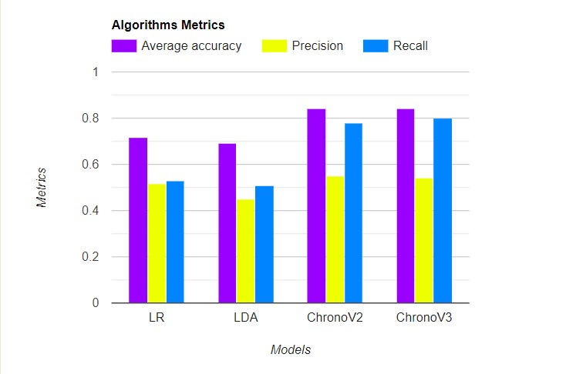
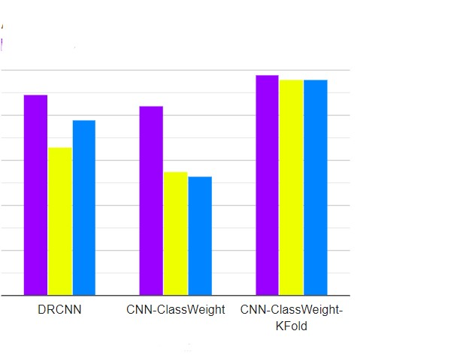
Results summary

Slide 33
4
Real-Time Application

Slide 34
Real-Time Application
The purpose of our application is to help the disabled people to use the mobile phone and perform some important functions through it using only brain signals, and since the main factor in our measures is EEG signal and capture the p300 peak, our mobile application consist of grids this grids flashing in random sequence every grid flashes for 100ms then all flashes pause for 300ms so we can capture if there is a P300 peak appear in the EEG signal or not.

Slide 35
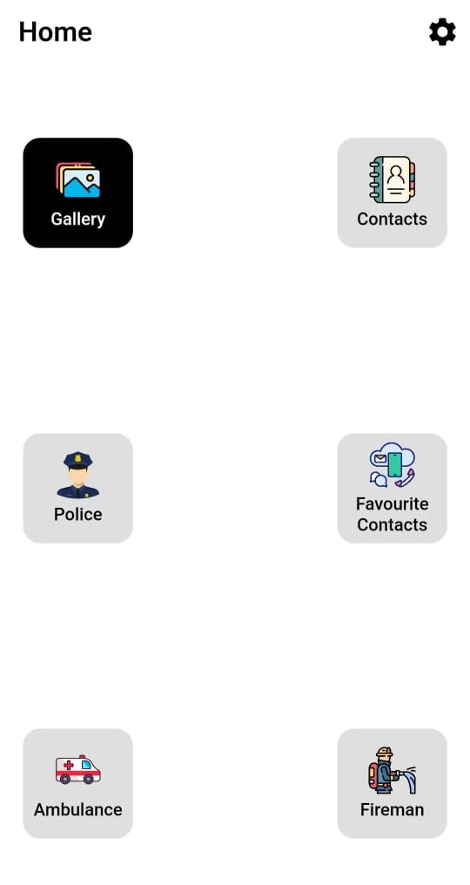
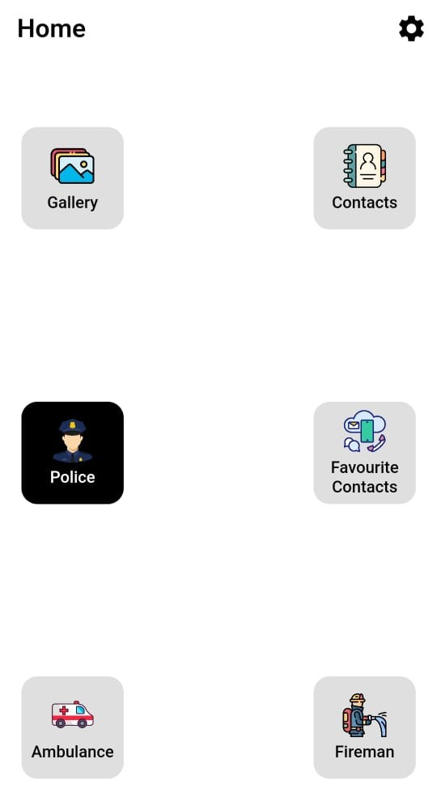
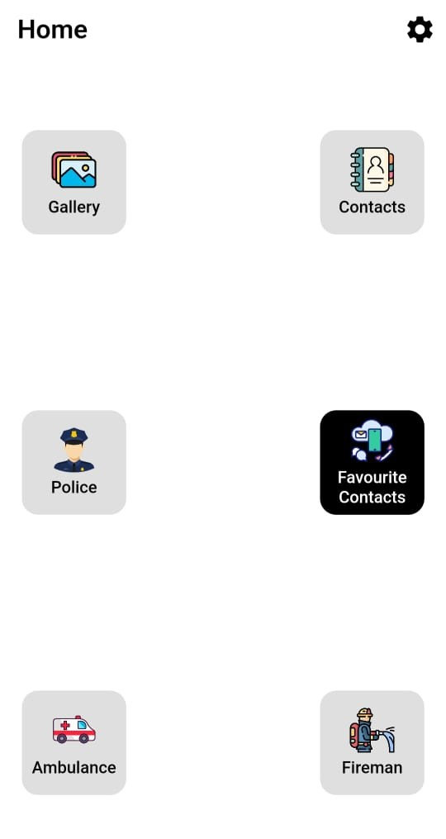
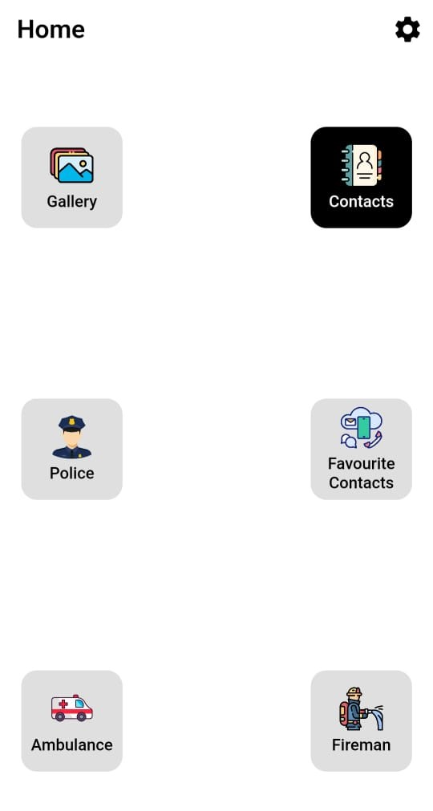

Slide 36
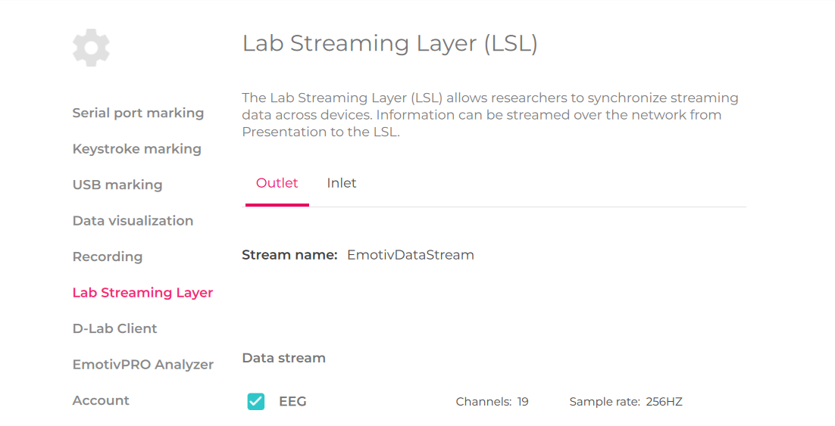
Our project flow is as follows: the first thing we plugged in EMOTIV headset with the dongle to the pc and connect it to the EMOTIV-PRO application then we start streaming data from Lab Streaming Layer option in the application

Slide 37
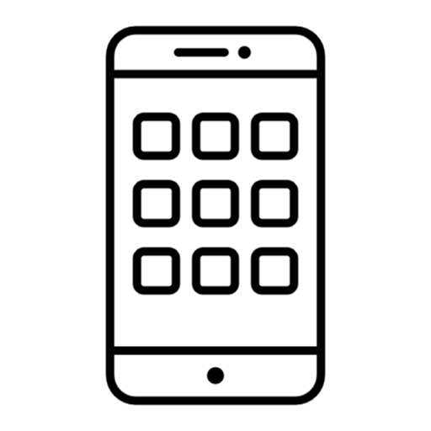
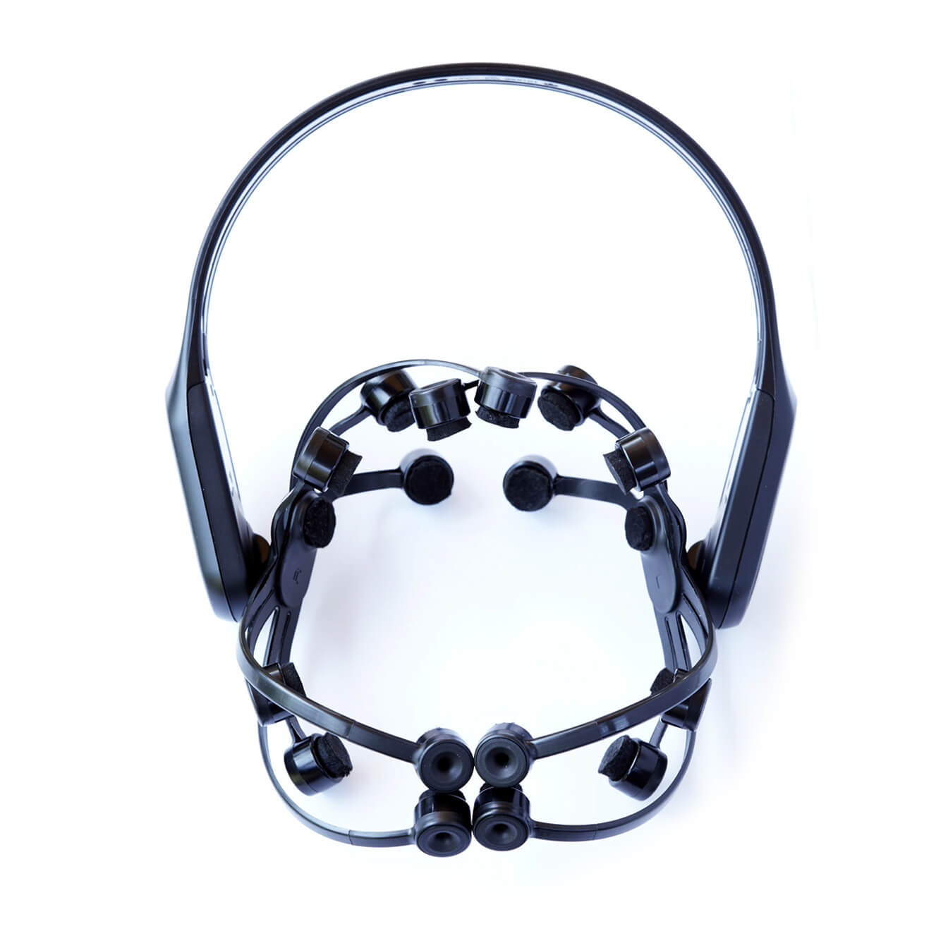
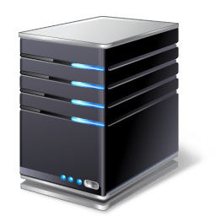
Real-Time Application Flow
EMOTIV Headset
Local Server
Mobile Application

Slide 38
5
Hardware

Slide 39
Electrodes
Electrodes can be defined as conductors that are used to make electrical contact with a non-metallic part of the circuit.
Electrodes types :
- The Hydrogel-Based Electrode System
The system allows the acquisition of up to 64 bio signals such as EEG, EMG, EOG, ECG
- The Water-Based Electrode System
- The Dry-based Electrode System

Slide 40
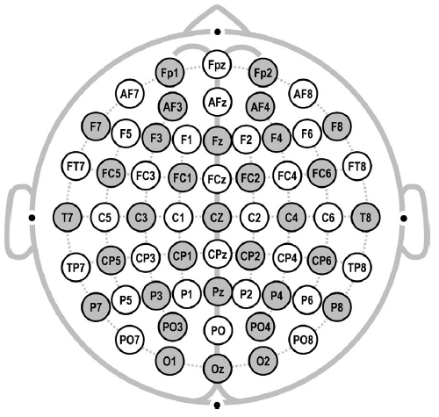
1020 system

Slide 41
Amplifier circuit phases
Protection
Preamplifier
Notch Filter
2-pole HPF
Low pass filter
Main Amplifier
ADC
Software

Slide 42
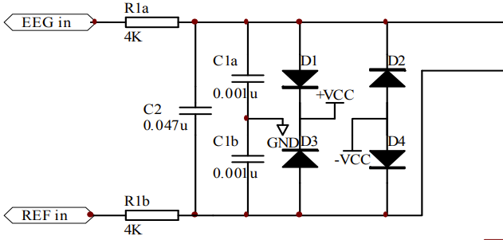
Protection

Slide 43
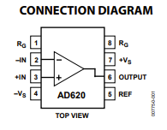
Amplifier
Voltage range 2-18V
Gain = (1+49400)/RG
It does not work perfectly

Slide 44
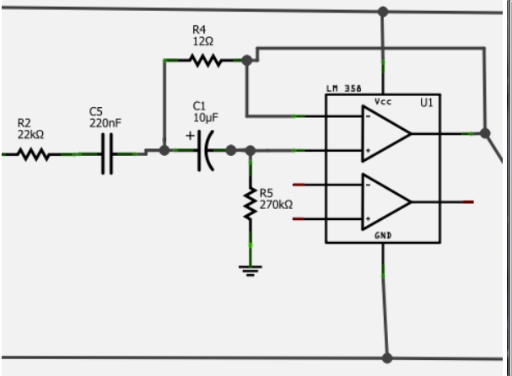
Notch filter
Removes Power line noise (60)Hz.

Slide 45
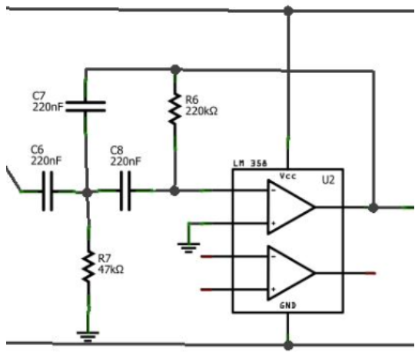
2-Pole HPF
As we are measuring data across the skin, our final data will also contain voltage from our galvanic skin response across our head. This will obscure the brain data we want, and as this interference is primarily low frequency, it can be fairly easily filtered out with a high pass filter (HPF). The trade-off doing this is that we also filter out a lot of gamma/delta wave data (the brain waves that are about 8 Hz and less), but if our main focus is alpha/beta wave monitoring, this isn't much of a problem.

Slide 46
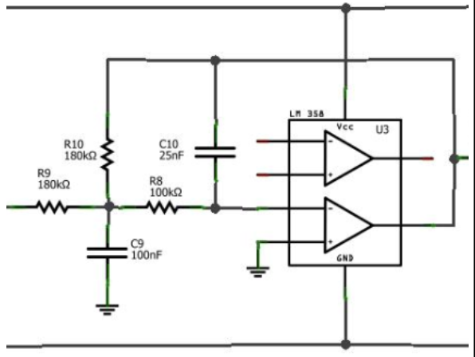
Low pass filter (30)
Next up, we want to filter out data above the frequencies we are interested in. More specifically, as beta wave information stops out at 30Hz, we want to get rid of anything above that, as combined it can contribute a good amount of noise to our data. The circuit design is very similar to the high pass filter from stage 3 - it has a gain of .71 at 31.23Hz and decreases from there at a rate such that by 300Hz it has attenuated the data by about a factor of 100.

Slide 47
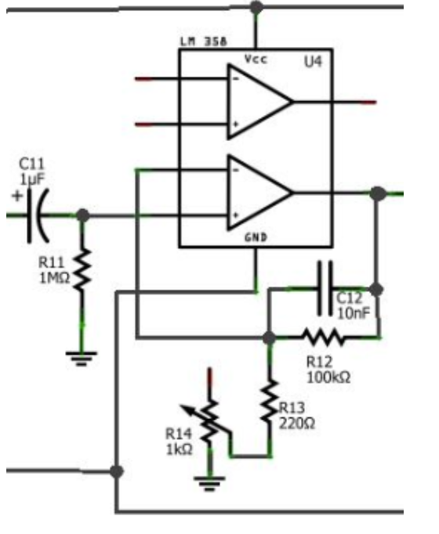
Another amplifier
Gain is on range(83-455) depending on the resistance value.
About 10 to 30 uV. Using a middle value of 20 uV, this means the ending voltage reading could range from 83*89.2*20e-6 = .148V to 455*89.2*20e-6 = .81172V.

Slide 48
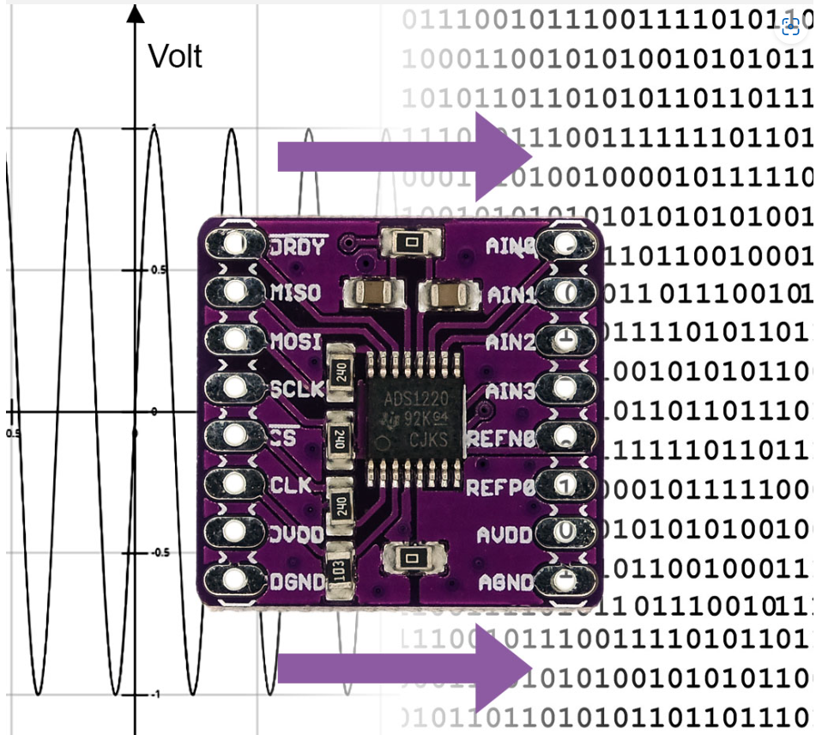
4-channel, 24-bit ADC ADS1220

Slide 49
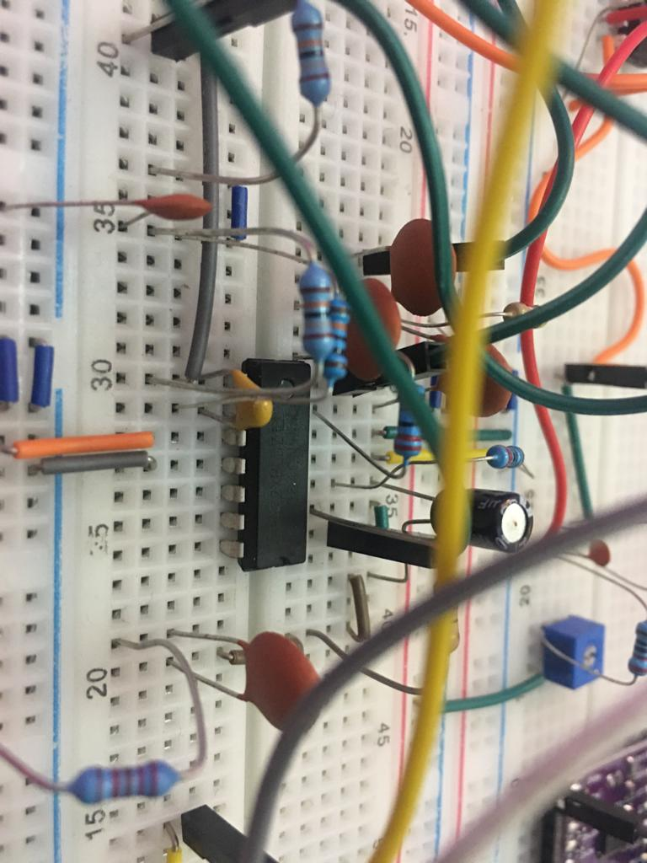
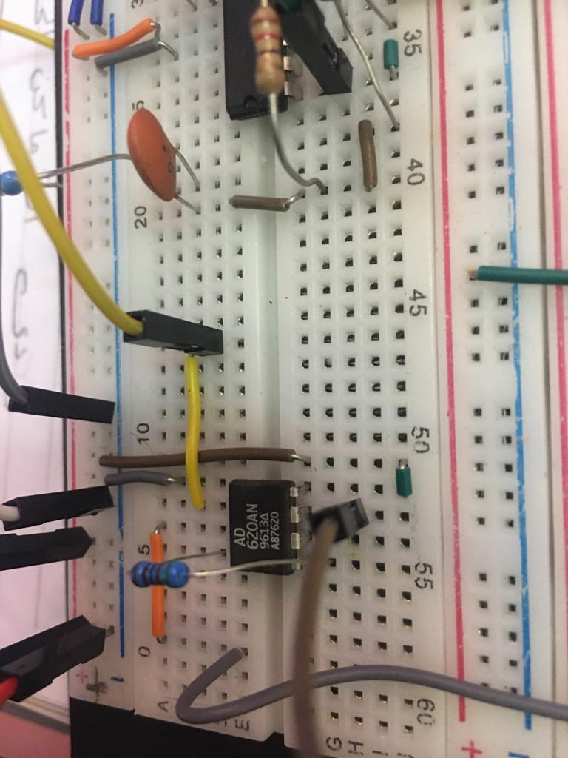
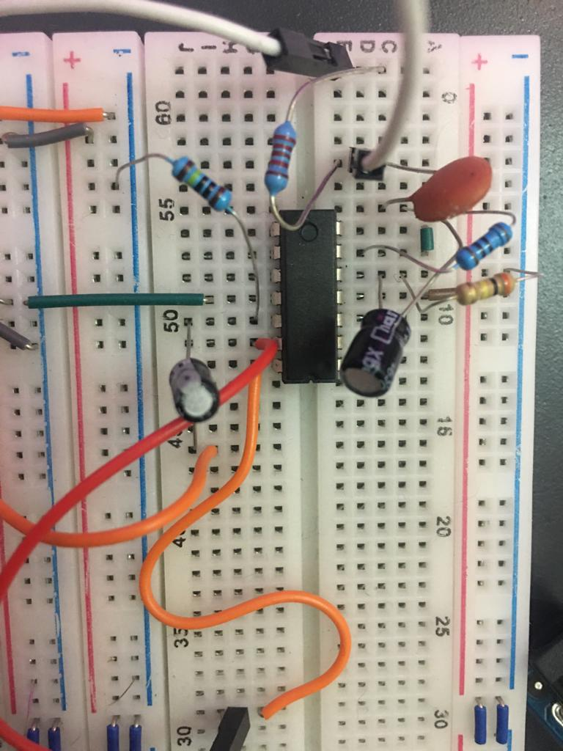
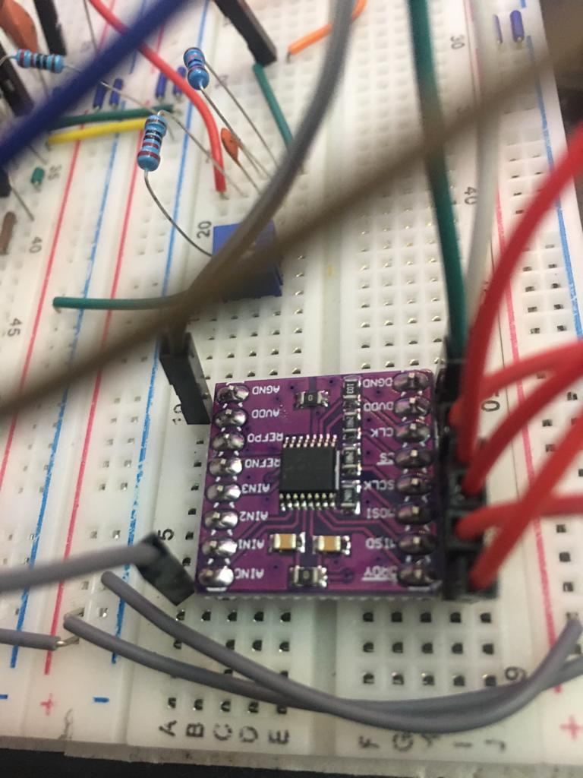
Hardware Circuit
HPF-LPF
Preamplifier
Main amplifier
ADC converter

Slide 50
EMOTIV
The EMOTIV headset is a wearable device designed to capture and interpret brain
activity with a non-invasive way for various applications . It utilizes
electroencephalography (EEG) technology to detect and measure electrical
signals generated by the brain. EMOTIV headsets typically have 14 or 24 electrodes
that are placed on the scalp with specific locations, these locations defined by a
system called ten-twenty system
In our project, we use a certain type of EMOTIV headset called EMOTIV epoch x
which consists of 14 electrodes and 2 references channels

Slide 51
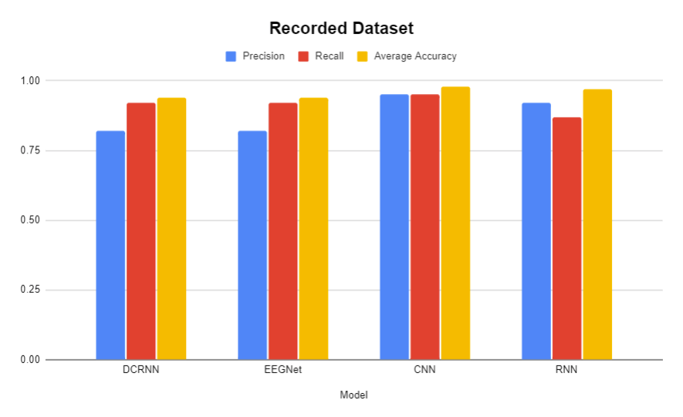
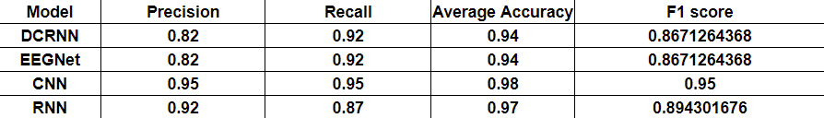
Emotiv Results

Slide 52
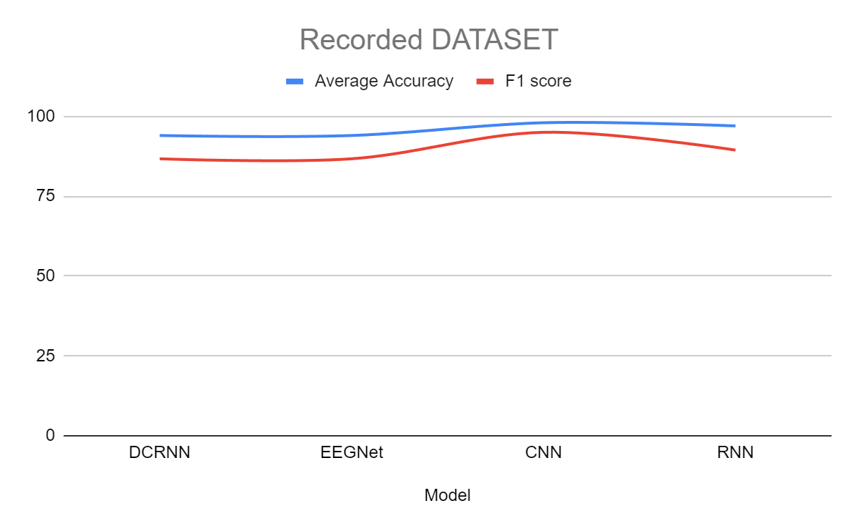

Slide 53
6
Next phases (challenges/enhancement)

Slide 54
Next Steps
Work on a bigger dataset that has more subjects
Achieve subject independency (started)
Continue building the hardware
Test the hardware

Slide 55
Fundings
We got accepted in 2 fundings:
Information Technology Academic Collaboration (ITAC)
Egyptian Academy of Scientific Research and Technology

Slide 56
Resources
An efficient P300-based brain–computer interface for disabled subjects
EPFL dataset

Slide 57






Tech Stack

Slide 58

Thank you

